Slide 1

Security and DHIS2
Bob Jolliffe

Slide 2
Background
DHIS2 has been around from around 2008
Early implementations were quite naive (frequently no ssl, tomcat running as root, no dns etc etc) - dhis2-tools was created to address some of these
Poorly configured user/role/sharing
Ownership and governance issues - where is it hosted, who controls the account, who has backend access, how is security managed etc

Slide 3
Maturing …..
The surge of interest in DHIS2 Tracker, which enables the collection, storage and processing of identifiable data on rights-bearing subjects (humans), raises the bar in terms of what is acceptable security practice.
The increasingly hostile nature of the internet as an environment for hosting resulting from a growing prevalence of criminal activity as well as hostile state and other actors.
The growth in size of country systems require them to be better managed from a performance perspective as well a steadily increasing value of the data.

Slide 4
You need a security plan
A security plan (sometimes called the security posture of the organisation) outlines the overall management approach to security.
It refers to the principles, policies, artefacts and people who make up the security management system.
Very hard to do bottom up. Security is not the the primary mandate of technicians and developers.
Methodologies exist eg. ISO27001. Need to be adapted.
A bad plan is better than no plan. It is meant to be dynamic.

Slide 5
High level principles
An organisation that claims to take security seriously must have an explicit security plan or posture. What principles are important? What legislation/regulations apply? What processes and artefacts exist to manage security?
Whose job is it? Is that person(s) sufficiently empowered and mandated to do the job?
"The cloud" and "the web" are just metaphors. Donors are temporary partners. Real systems have real concrete implications for cost, human capacity, maintenance, accounting etc. Stay real.

Slide 6
High level principles
Human beings are supposed to enjoy recognition of certain rights, including the protection of privacy. Failure to protect the privacy of subjects in the DHIS2 application can lead to very tangible actual harm as well as blackmail, harassment, identity theft etc. As a system implementer you have the obligation to be able to demonstrate that adequate and appropriate provisons are being taken. (1 and 2 above are generally the first steps in making such a demonstration)
Both individual and aggregate data related to health can be critical to the ongoing treatment of patients as well as management of the system. Data which is lost or altered can have bad consequences. Implementers must also be able to demonstrate that adequate and appropriate provisions are taken to protect the availability and integrity of data. Again refer to 1 and 2 above.

Slide 7
High level principles
An increasing number of countries have laws which aim to protect the data rights of citizens and others. Not paying sufficient attention to the above can lead to implementers, engineers and others falling foul of the law. Obey the law.
Most data is lost through negligence/ignorance rather than hostile actions. A regularly tested and automated backup plan is not an additional luxury feature.
Sunlight is the best cure for mud. We need to open up systems for audit, peer evaluation etc

Slide 8
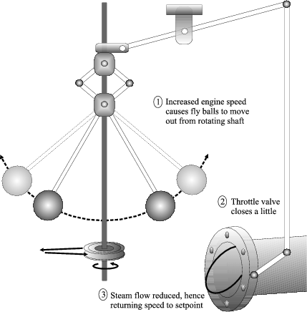
Governance (courtesy of James Watt)
There are targets
There is reality which needs to be measured/monitored
There are actions which respond to the difference between reality and targets
A plan involving people is more complicated than steel balls. But the same feedback loop applies.

Slide 9
Basic components of a security management system
A Plan
Somebody with the mandate to implement the plan
Methods for assessing risks, incident response etc
Corrective actions
Monitoring, evaluation, adaption
ISO27001 - Plan Do Act
Some useful material - https://www.iso27001security.com/html/toolkit.html

Slide 10
Some bad things which have happened
Some key person left and all the data was lost
The disk died, server room burned and all the data was lost
The cloud services account was not paid and the system was inaccessable for 2 months
The database was exposed on a public IP (with no username and password required)
Hacks:
A vulnerability gave attacker full access to files on disk
A vulnerability allowed remote code execution on host
A vulnerability allowed hacker to create a new superuser account
Unknown (????)

Slide 11
Some ongoing security projects
Development of simplified ISO27000-like process
Penetration testing of DHIS2
Development of Web App Firewall (WAF) rules for DHIS2
Application of OWASP ASVS (security by design)
Development of more secure deployment tooling (thats us!)

Slide 12
Takeaways
Security is difficult
It is always about people never just technology
Even where we are not good at it, we are obliged to try and improve

Slide 13
Thank you (stay safe)

